Slide 1
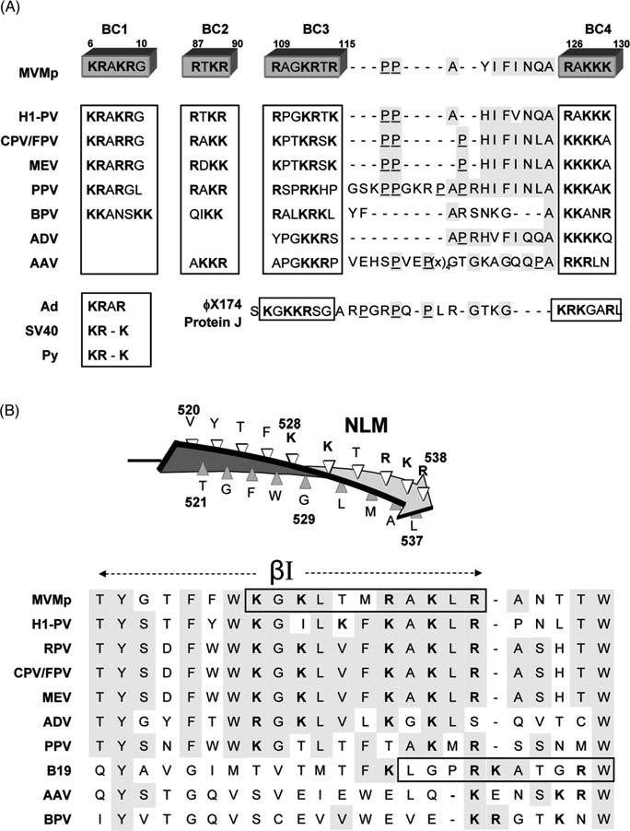
BC1
BC2
BC3
BC4
6
10
87
90
109
115
126
130
MVMp
H1-PV
CPV/FPV
MEV
PPV
BPV
AMDV
AAV
Ad
SV40
Py
ΦX174 (Protein J)
KRAKRG
KRAKRG
KRARRG
KRARRG
KRARGL
KKANSKK
KRAR
KR-K
KR-K
RTKR
RTKR
RAKK
RDKK
RAKR
QIKK
AKKR
RAGKRTR
RPGKRTK
KPTKRSK
KPTKRSK
RSPRKHP
RALKRKL
YPGKKRS
APGKKRP
S KGKKRSG A
---PP----A--YIFINQA
---PP----A--HIFVNQA
---PP-----P-HIFINLA
---PP-----P-HIFINLA
GSKPPGKRPAPRHIFINLA
YF-------ARSNKG---A
---------APRHVFIQQA
VEHSPVEP GTGKAGQQPA
RPGRPQ-PLR-GTKG----
RAKKK
RAKKK
KKKKA
KKKKA
KKKAK
KKANR
KKKKQ
RKRLN
KRKGARL
(x)₄
VP1u
NLM
βI

